Slide 1

Fake news detection using machine learning
Ronish shrestha Kce075bct032
Roshan shrestha Kce075bct033
Rubin baidhya Kce075bct034
Sairush tamang kce075bct036

Slide 2
Fake news is:
Incorrect information that might be lies
Spread mostly through social medias
For false promotion and personal gains
Creates trouble and chaos among people and society
Can be solved through AI algorithms

Slide 3
Problem
Mislead the readers and create a devastating impact on people's mindset.
Encroach human right and public safety.
Not enough Nepali dataset.

Slide 4
objectives
Develop a system for recognizing and classifying news stories.
To create a model that can determine a fake news from real one.

Slide 5

Feasibility analysis
Time Feasibility
Size Feasibility
Technical Feasibility
Economic Feasibility
Operational Feasibility

Slide 6
Requirements analysis
Software Requirements
Functional Requirements
Non-Functional Requirements
System Requirements

Slide 7
Software Requirement
Python
Keras
TensorFlow
Beautiful Soup

Slide 8
Functional Requirements
Adaptable and elaborated from the point of view of the users.
01
Should figure out the news that are completely fake or not genuine
02
Should extract the news article from online news portal
03

Slide 9
Non-Functional requirements
Reliability
Maintainability
Performance
Accuracy

Slide 10

System requirement
Working PC with internet connection

Slide 11
Literature review
Author | Title | Features | Accuracy
Kaliyar, Rohit.K. | Fake News Detection Using A Deep Neural Network | It examines which model will provide the most accurate results and classify the news as fake or real | Naive Bayes: 90.19% Decision Tree: 75% Random Forest: 72% K Nearest Neighbour: 55% CNN and LSTM: 97.3%
Kaliyar, Rohit.K. Goswami, Anurag. Narang, Pratik. Sinha, Soumendu. | A deep convolutional neural network for fake news detection | 1) It uses pre-trained word embedding models 2) It uses GloVe enabled deep convolutional-based approach. | 98.3 % accuracy using FNDNet with Glove
Oshikawa, Ray. Jing, Qian. William. Y. | A Survey on Natural Language Processing for Fake News Detection | 1) It provides an overview of research efforts for fake news detection. 2) It analyzes how fake news detection is aligned with existing NLP tasks

Slide 12
Author | Title | Features | Accuracy
Ahmed, Hadeer Traore, Issa Saad, Sherif | Detecting opinion spams and fake news using text classification | 1) Detects both the fake reviews and fake news 2) Classification of fake news and fake reviews | SVM: 84% LVSM: 94% KNN: 83% DT: 89% SGD: 89% LR: 89%
Abbasi, Mohammad-Ali Liu, Huan | Measuring User Credibility in Social Media | 1) Detect user’s online behaviour and measure the credibility of user accordingly. 2) Shows how the users can spread misinformation in the society.
Granik, Mykhailo Mesyura, Volodymyr | Fake news detection using Naive Bayes Classifier | 1) Use Bag-of-words feature to identify spam 2) Much simplew AI algorithm to implement | Naive Bayes: 74%

Slide 13
Author | Title | Features | Accuracy
Umer, Muhammad. Imtiaz, Zainab. Ullah, Saleem. Mehmood, Arif. Choi, Gui. S. On, ByungWon. | Fake News Stance Detection Using Deep Learning Architecture(CNN-LSTM) | Automatically classifies the news articles with stance labels of either agree, disagree, unrelated, or discuss | 1)CNN-LSTM without Preprocessing: 78.4% 2)CNN-LSTM with Preprocessing: 93% 3)CNN-LSTM with chi-square: 95.2% 4) CNN-LSTM with PCA: 97.8%
Bahad, Pritika Saxena, Preeti Kamal, Raj | Fake News Detection using Bi-directional LSTM-Recurrent Neural Network | 1) Analyzes relationship between the article’s titles and it’s content 2) Trains data iteratively to increase accuracy | RNN-LSTM: 98%

Slide 14
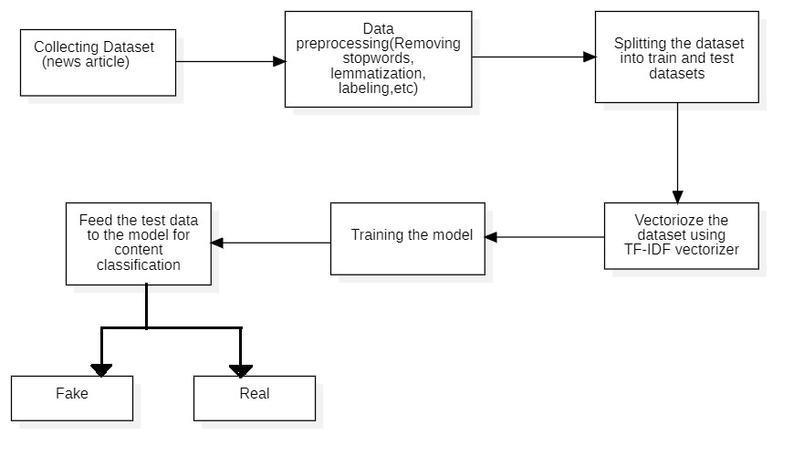
System overview
Fig. Block Diagram of system

Slide 15
methodology

Slide 16

Software development approach
Used Agile model
Dividing project in small sections
Developing them into a fully functional project.

Slide 17

Overall development phases
Planning phase
Development phase
Integration phase

Slide 18
Planning phase
Plans on how to move forward with the project

Slide 19
Development phase
Implementation initiated
Different parts developed and tested individually

Slide 20
Integration phase
Different parts Integrated
Testing

Slide 21
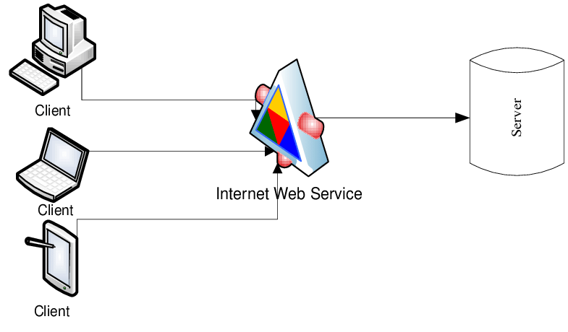
System design and architecture
A client server based architecture

Slide 22

Tools used
Google Collab
VScode
Github
Git
Jupyter
Python

Slide 23
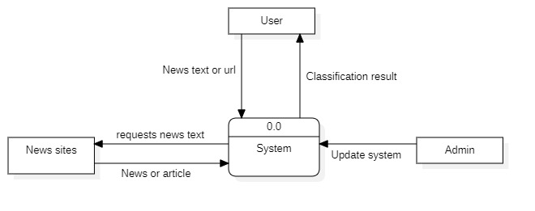
Data flow diagram
Figure: Level-0 DFD

Slide 24
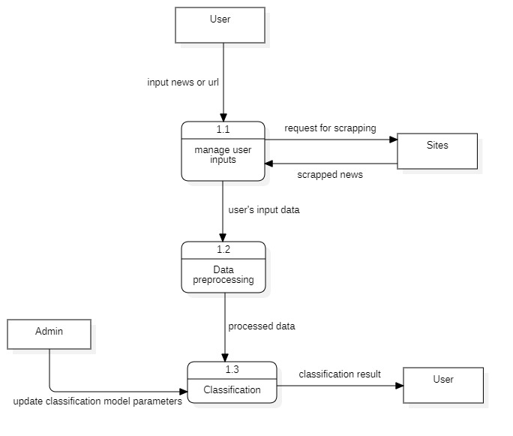
Figure: Level-1 DFD

Slide 25
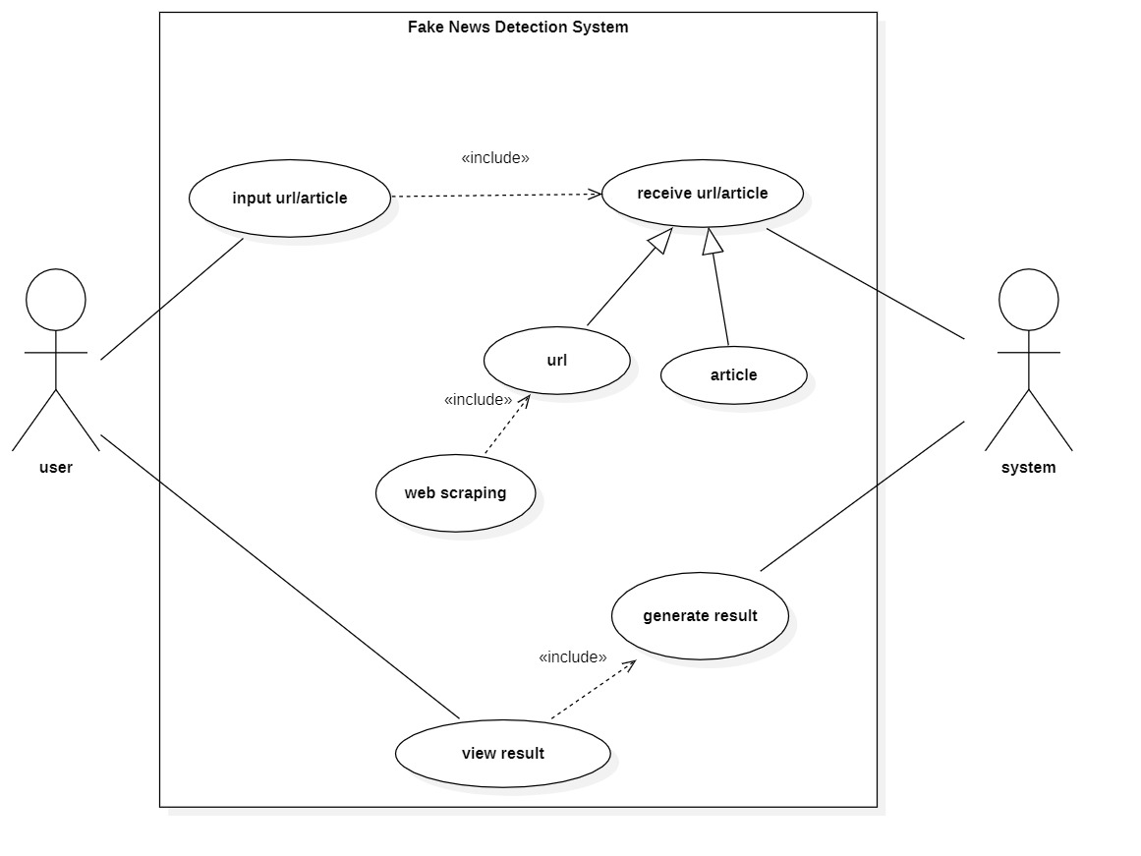
Use case diagram

Slide 26
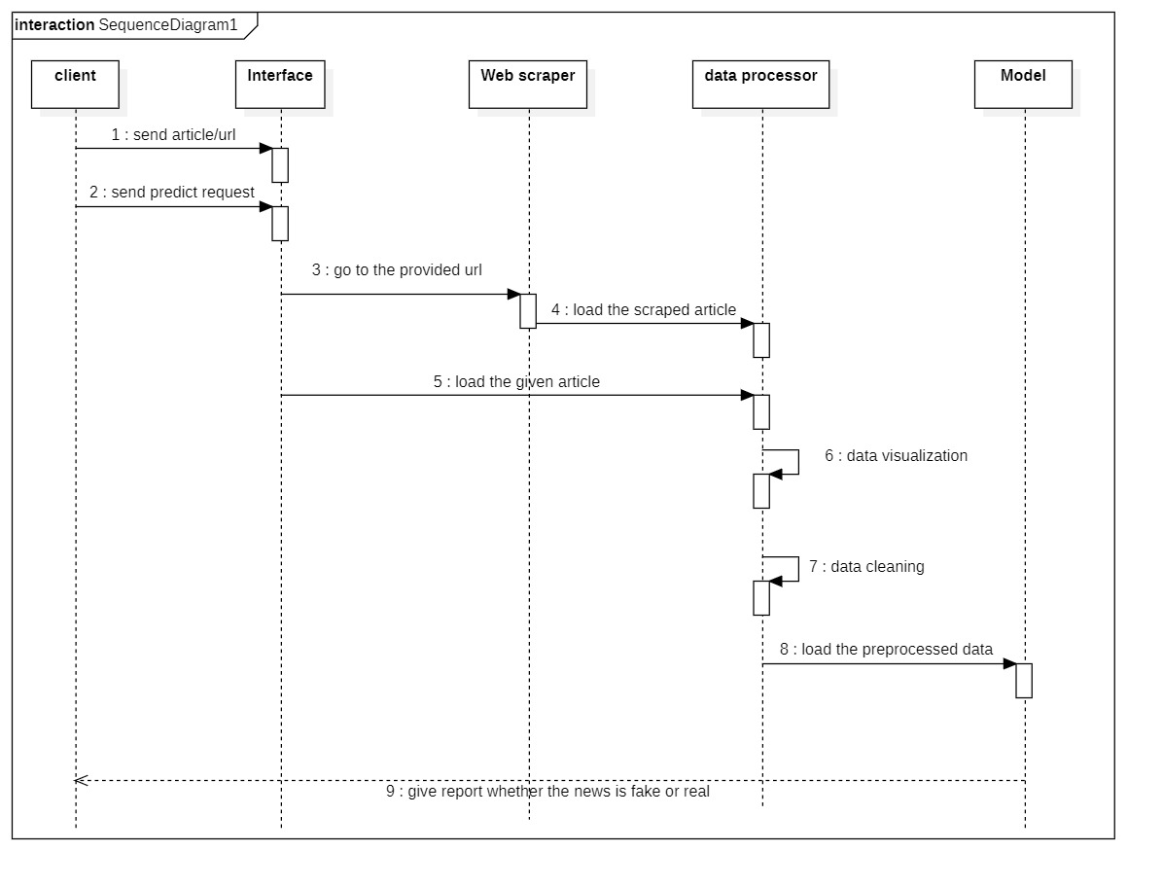
Sequence diagram

Slide 27
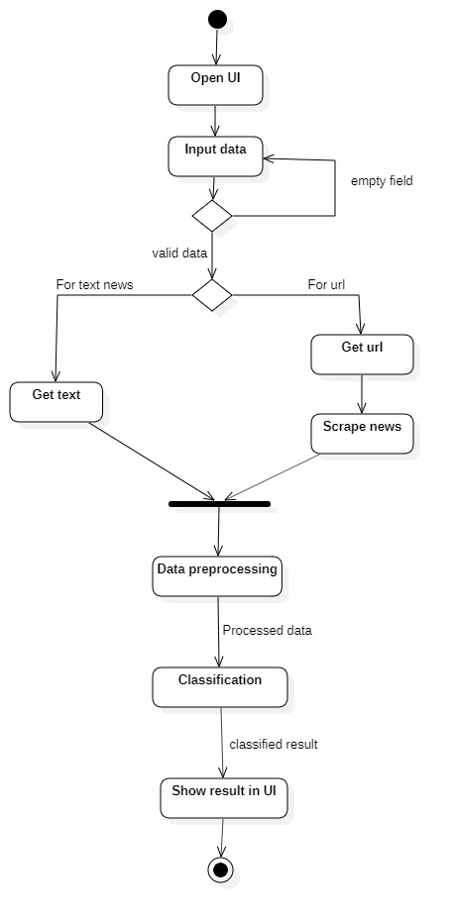
Activity diagram

Slide 28

Dataset collection
Datasets are collected from:
Kaggle
Number of True data = 21417
Number of Fake data = 23460

Slide 29
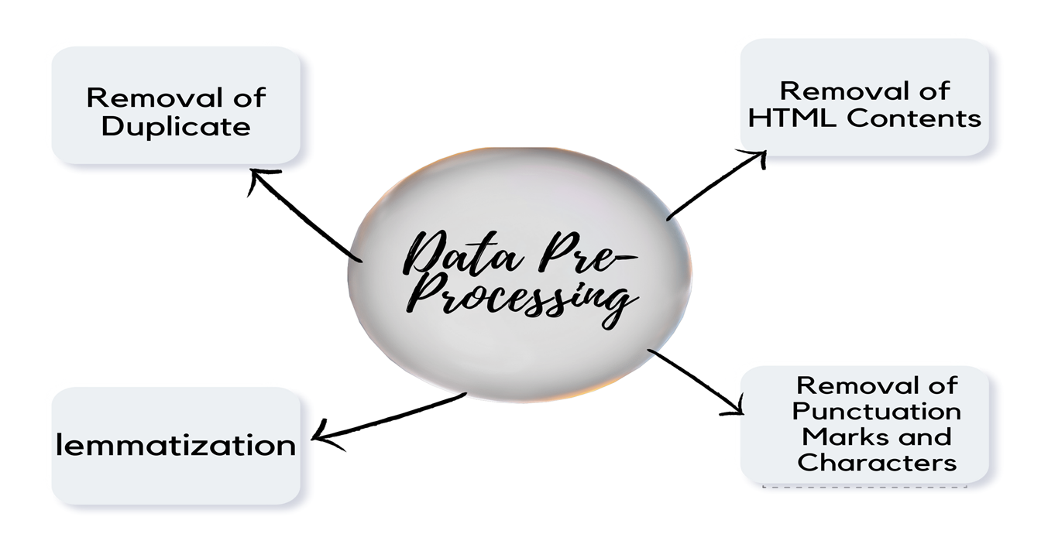
Dataset preprocessing

Slide 30
Why lstm??
Well suited for classification and predictions
Understand context along with recent dependencies
Can deal with vanishing gradient problem seen in RNN

Slide 31
Why svm??
Best for Text Classification
Uses Kernel function
Can be used for Linear and Non-linear data.

Slide 32
implementation
A Web site

Slide 33
scope
Help in minimizing spread of disinformation
1
Protect people's right to true information
2
Identify real news from fake news
3

Slide 34
limitations
Only one domain(politics).
Only for English Language.
Lower accuracy for real world data.

Slide 35
Future enhancements
Using custom datasets
01
Expanding our domain
02
Creating nepali datasets for nepali news detection
03
Increasing accuracy for real-world data
04

Slide 36

conclusion
Implemented SVM and LSTM classifier to distinguish whether the news is True or Fake.

Slide 37
references
[1] R. K. Kaliyar, “Fake news detection using a deep neural network,” in 2018 4th International Conference on Computing Communication and Automation (ICCCA). IEEE, 2018, pp. 1–7.
[2] R. K. Kaliyar, A. Goswami, P. Narang, and S. Sinha, “Fndnet–a deep convolutional neural network for fake news detection,” Cognitive Systems Research, vol. 61, pp. 32–44, 2020.
[3] H. Ahmed, I. Traore, and S. Saad, “Detecting opinion spams and fake news using text classification,” Security and Privacy, vol. 1, no. 1, p. e9, 2018.
[4] M.-A. Abbasi and H. Liu, “Measuring user credibility in social media,” in Social Computing, Behavioral-Cultural Modeling and Prediction, A. M. Greenberg, W. G. Kennedy, and N. D. Bos, Eds. Berlin, Heidelberg: Springer Berlin Heidelberg, 2013, pp. 441–448.
[5] M. Granik and V. Mesyura, “Fake news detection using naive bayes classifier,” in 2017 IEEE First Ukraine Conference on Electrical and Computer Engineering (UKRCON), 2017, pp. 900–903.
[6] S. Gilda, “Notice of violation of ieee publication principles: Evaluating machine learning algorithms for fake news detection,” in 2017 IEEE 15th Student Conference on Research and Development (SCOReD), 2017, pp. 110–115.
[7] P. Bahad, P. Saxena, and R. Kamal, “Fake news detection using bi-directional lstm-recurrent neural network,” Procedia Computer Science, vol. 165, pp. 74–82, 2019, 2nd International Conference on Recent Trends in Advanced Computing ICRTAC -DISRUP - TIV INNOVATION , 2019 November 11-12, 2019. [Online]. Available: https://www.sciencedirect.com/ science/article/pii/S1877050920300806
[8] R. Oshikawa, J. Qian, and W. Y. Wang, “A survey on natural language processing for fake news detection,” arXiv preprint arXiv:1811.00770, 2018.
[9] M. Umer, Z. Imtiaz, S. Ullah, A. Mehmood, G. S. Choi, and B.-W. On, “Fake news stance detection using deep learning architecture (cnn-lstm),” IEEE Access, vol. 8, pp. 156 695–156 706, 2020.
[10] M. G. Hussain, M. Rashidul Hasan, M. Rahman, J. Protim, and S. Al Hasan, “Detection of bangla fake news using mnb and svm classifier,” in 2020 International Conference on Computing, Electronics Communications Engineering (iCCECE), 2020, pp. 81–85.
[11] J. Shaikh and R. Patil, “Fake news detection using machine learning,” in 2020 IEEE International Symposium on Sustainable Energy, Signal Processing and Cyber Security (iSSSC), 2020, pp. 1–5.

Slide 38
appendix

Slide 39
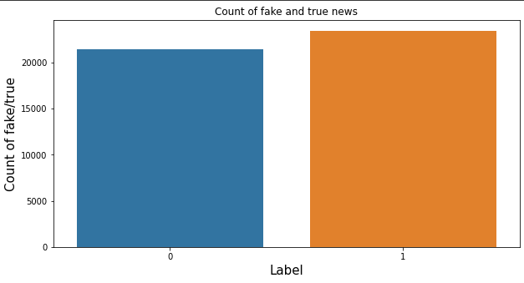
Appendix contd...
B. Snapshots
B.1 Fake news and Real news count:

Slide 40
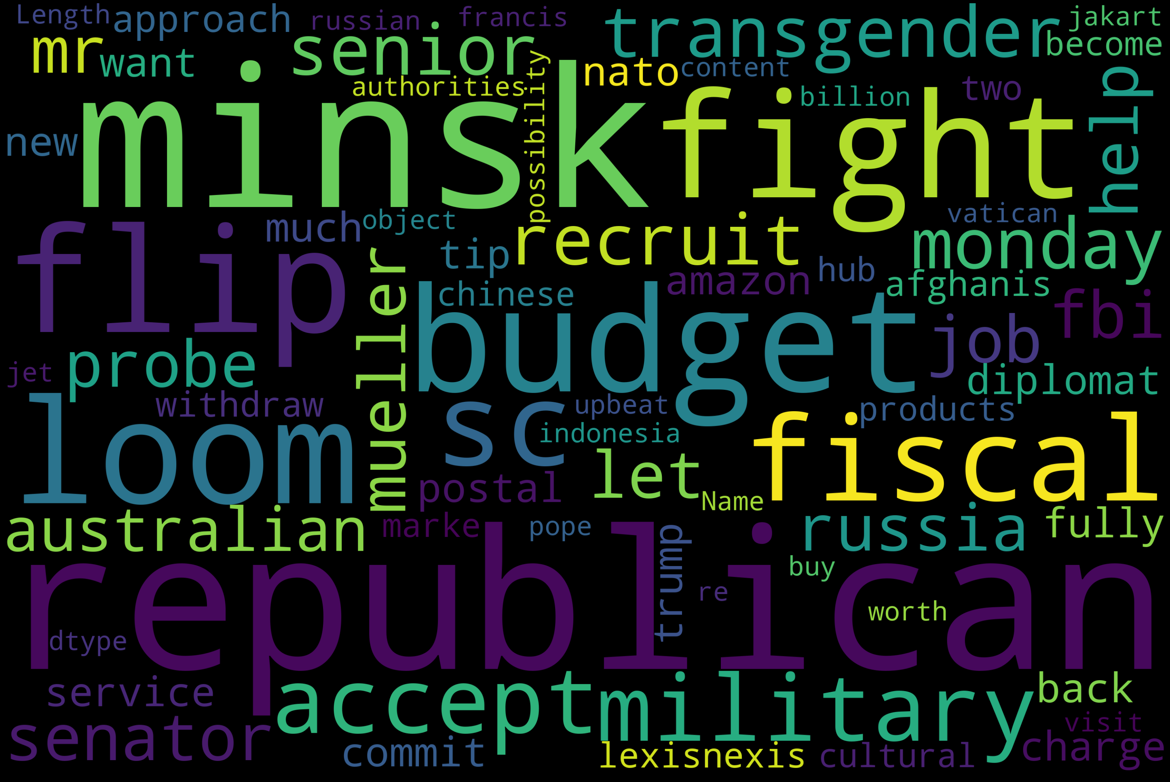
Appendix contd...
B2. True news web cloud

Slide 41
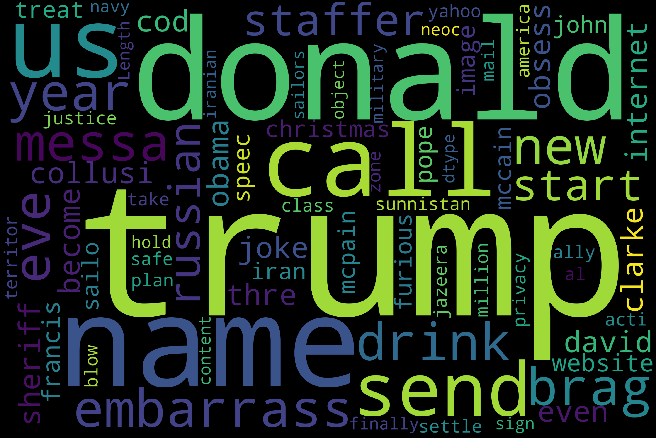
Appendix contd...
B3. Fake news word cloud:

Slide 42
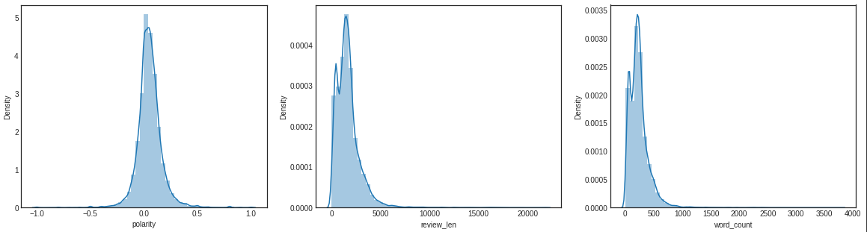
Appendix contd...
B.4 Features extraction:

Slide 43
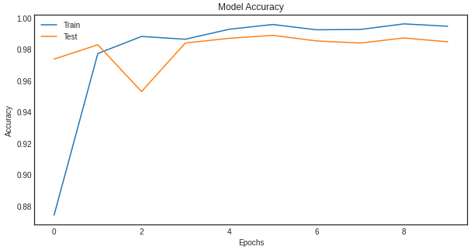
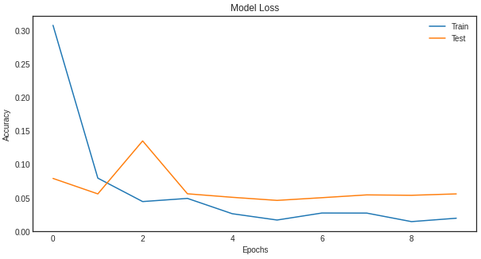
Appendix contd...
B.5 Accuracy for training and testing of data:
B.6 Loss for training and testing of data
Accuracy plot
Loss plot

Slide 44
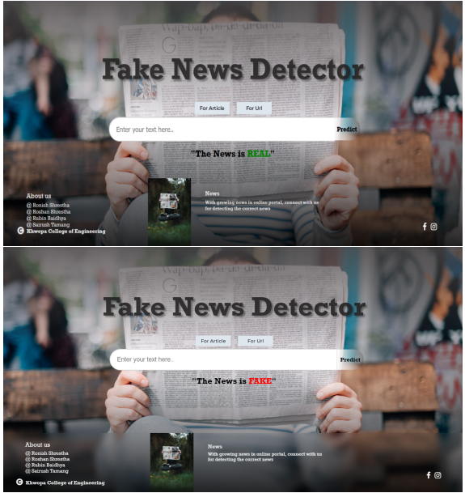
Appendix contd...
B7. Desktop Outcome

Slide 45
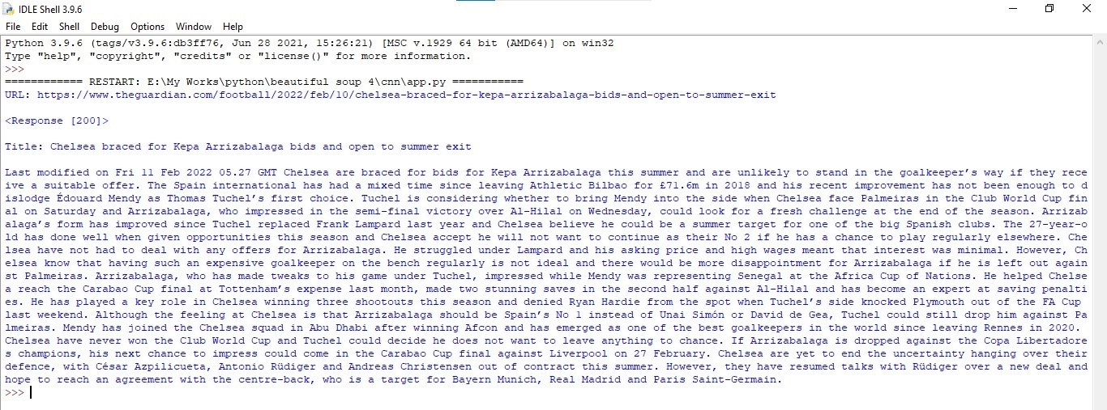
appendix contd. Web scraping b8

